Slide 1
Trichoptera Digital Reference

Slide 2
Order: Trichoptera
Identification
larvae are caterpillar like, but their legs are much longer and they have no prolegs on the abdomen.
They have a pair of distinctive hooks on the end of their abdomen that they use to anchor themselves with.
Some species have prominent finger-like gills on the abdomen,
but others may have little or none visible.
The antennae of caddisflies are usually very short and inconspicuous.
Cases can help greatly in identifying larval caddisflies.

Slide 3
Order: Trichoptera
Short anal prolegs without joints at end of abdomen, with pointed claws
No wing pads
Larvae are usually cylindrical and “C” shaped
3 pairs of thoracic legs near head
Single Tarsal Claw
Abdominal gills

Slide 4
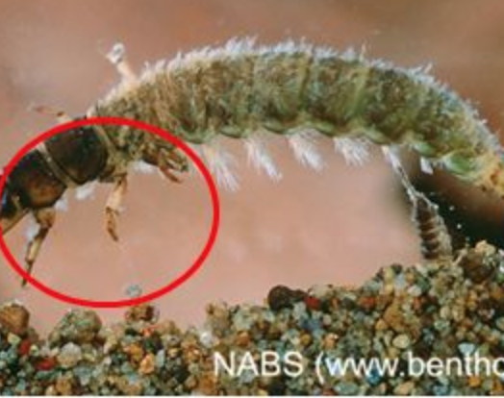
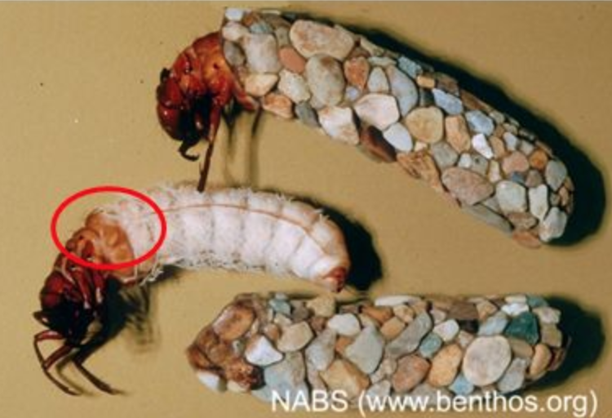
Order: Trichoptera
Silky hairs cover much of body and wings
3 pairs of jointed legs on thorax
1 pair of terminal abdominal prolegs
Often in cases

Slide 5
Order: Trichoptera
Head subdivided into 3 parts by Y-shaped lines

Slide 6
Family: Hydropsychidae
Ventrolateral rows of branched gills
Brush of hairs at base of anal claw
Anal claw hook shaped
3 thoracic segments have sclerotized dorsal plates present

Slide 7
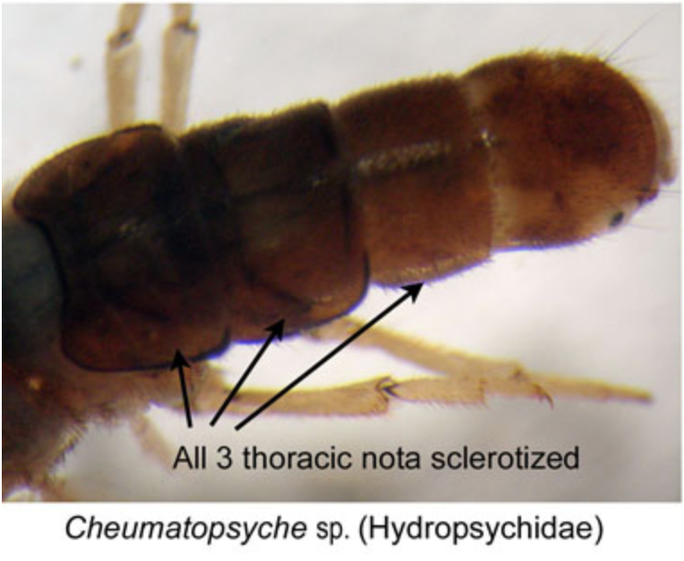
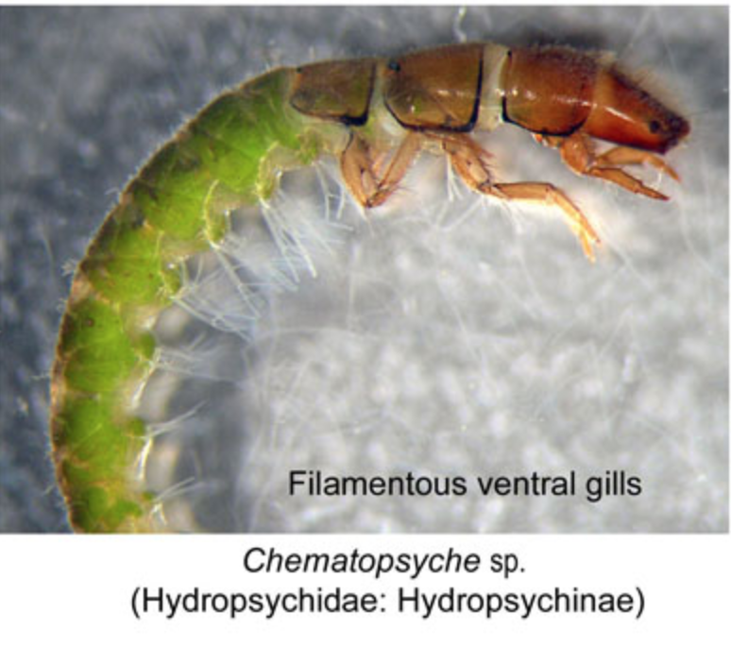
Family: Hydropsychidae Cheumatopsyche sp.
All 3 thoracic nota sclerotized
Filamentous ventral gills
Anterior notch on the clypeus (dorsalsurface) of the head (Fig. B)
On abdominal segment IX for notches in the sclerites (Fig. C).
Between the first and second sets of legs (Fig. D), These small sclarites are posterior to the posternal plate (Fig. E).

Slide 8
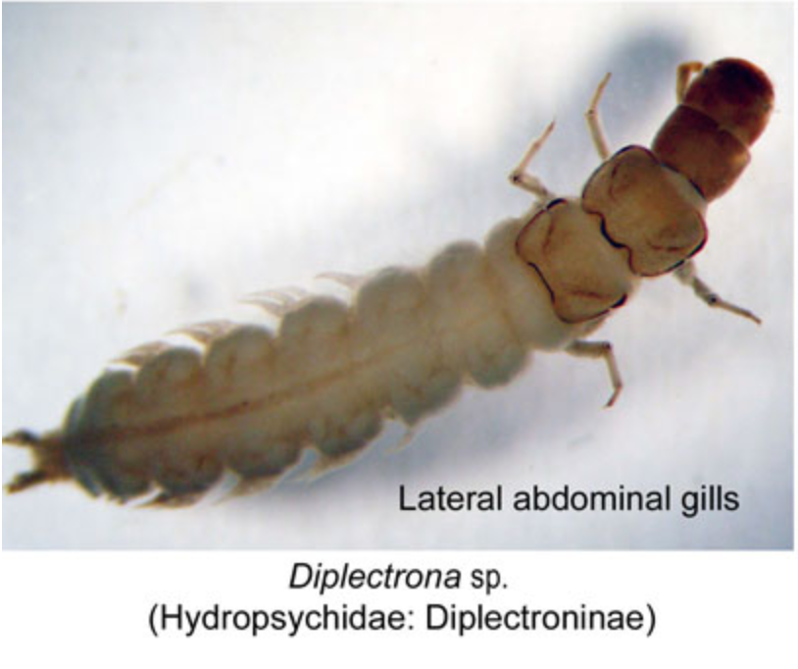
Family: Hydropsychidae Diplectrona sp.
Lateral abdominal gills

Slide 9
Family: Hydropsychidae Hydropsyche sp.
On the underside of the thorax, between the first two pairs of legs (Fig. B), to find two large sclerites (Fig. C).
Scale hairs on the abdomen (Fig. D).
These hairs are plain and lack the thick, club hairs. For a better look at these hairs zoom in to 80x (Fig. E).

Slide 10
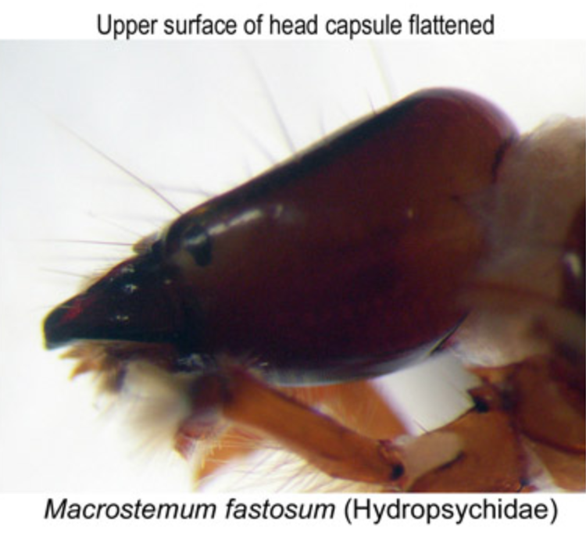
Family: Hydropsychidae Macrostemum sp.
Upper surface of head capsule flattened

Slide 11
Family: Hydropsychidae Potamyia sp.
on the ventral side of the head (Fig. B). What you are looking for is a projection on the ventral apotome of the head (Fig. C).
The second feature is located on the ninth segment of the abdomen.
Here the posterior part of each sclerite is complete (Fig. D).
Another feature that may help identification is a small set of sclerites that are visible between the first and second set of legs (Fig. E).

Slide 12
Family: Hydropsychidae Smicridea sp.

Slide 13
Family: Helicopsychidae Helicopsyche sp.
body is strongly curved (Fig. A).
anal claw has a comb of teeth (Fig. B)
dorsalside of their second thoracic segment has well develped or connecting sclerites (Fig. C)
snailcase makers are named for their snail shaped case (Fig. D).

Slide 14
Family: Limnophilidae
The northern casemakers are a diverse group that are sometimes difficult to identify.
The anal claw of Limnephilidae has a lateral sclerite (Fig. B).
They almost always have a posternal horn (Fig. C).
They almost always have a median dorsal hump on the first abdominal segment (Fig. D)
usually will also have lateral humps on this segment.
The dorsal side of the second thoracic segment usually is covered by two large sclerites
the third thoracic segment usually has several smaller sclerites (Fig. E).

Slide 15
Family: Limnophilidae Pycnopsyche sp.
The ninth abdominal segment (Fig B) has a single seta at the side of the dorsal sclerite(Fig. C).
On abdominal segment 1, you�ll find one long sclerite at the base of each lateral hump (Fig. D).
The case is made of leaves, twigs, or gravel (Fig. E).
The arrow is pointing to the head of the Pycnopsyche.

Slide 16
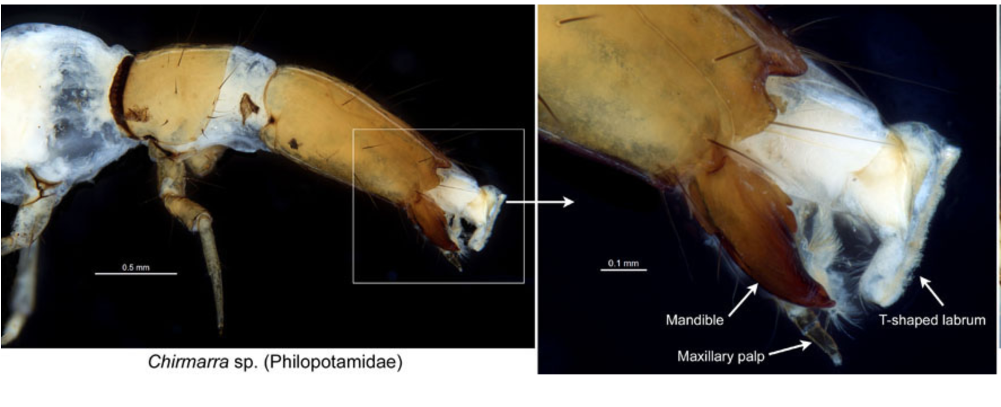
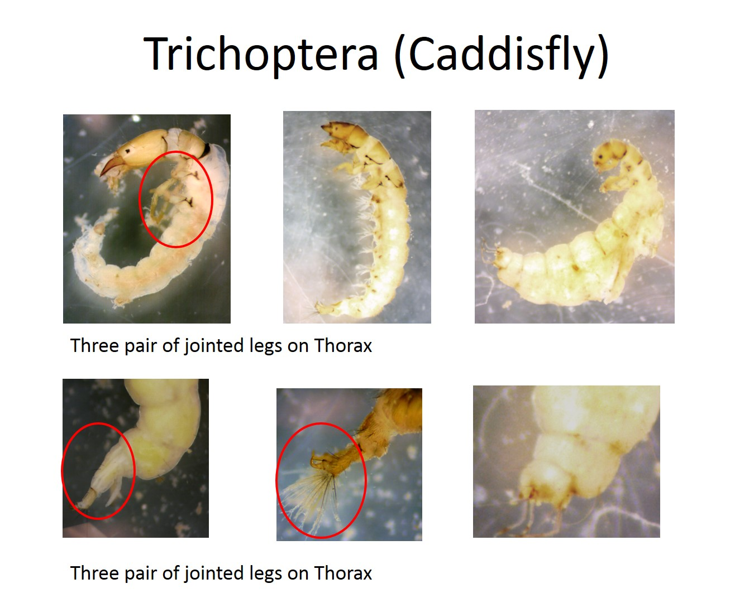
Family: Philopotamidae
labrum, a pair of strong mandibles and a composite structure of a pair of short maxillae and a labium.
Labrum highly modified into a membranous T-shaped structure that is a family trait of Philopotamidae.

Slide 17
Family: Philopotamidae Chimarra sp.
Unlike the first segment of the thorax, segments one and two are not covered by a sclerite (Fig. B).
The abdominal segment IX of the family Philopotamidae lacks a sclerotized plate on dorsum (Fig. C).
The distinctive feature of this family is the T-shaped labrum (Fig. D, black bracket).
The genus Chimarra also has an asymetrically notched frontoclypeal apotome (Fig. D, white arrows).

Slide 18
Family: Philopotamidae Dolophilodes sp.

Slide 19
Family: Hydroptilidae
The micro caddisflies can be recognized by their small size and well developed, sclerotized plates on all three thoracic segments (Fig. B).
The abdomen lacking ventrolateral gills(Fig. C).
They usually have 2-3 hairs at the base of the anal claw (Fig. D).
Many have areas of the abdomen expanded in different ways and their are a variety of cases that aid in identification of the insect.
One example of those cases is shown in figure E.

Slide 20
Family: Hydroptilidae Hydroptila sp.
The case of Hydroptilla is made of silk and covered with sand (Fig. B).
For determining Hydroptila first look at the anteroventral corners on the last segment of the pronotum, the corners are not 90 degrees (Fig. C).
Next look on abdominal segment IX for three filamentous gills (Fig. D).

Slide 21
Family: Hydroptilidae Leucotrichia sp.

Slide 22
Family: Hydroptilidae Mayatrichia sp.
The genera Mayatrichia is very similar to Neotrichia.
They can be determined by their case, which is made entirely of silk and tapers towards the end (Fig. B).
The legs of Mayatrichia are more compact than Neotrichia (Fig. C).
The Mayatrichia we have collected in North Dakota lack a lateral fringe of hairs on its abdomen (Fig. D).

Slide 23
Family: Hydroptilidae Ochrotichia sp.
The cases of Ochrotrichia are two sided and composed of silk, covered with sand particles (Fig. B).
The sclerites of these Hydroptilidae have anterolateral lobes (Fig. C). However this is not as prominent in all specimens.
Some species of Ochrotrichia may have bumps on the abdomominal segment 4 (Fig. D).

Slide 24
Family: Hydroptilidae Oxyethira sp.
The case is made completely of silk and resembles a compressed flask (Fig. B).Oxyethira also is identified by the second and third pairs of legs that are considerably longer than the first pair (Fig. C). Another characteristic is on the front leg (Fig. D), the tibia has a distal lobe (Fig. E).

Slide 25
Family: Hydroptilidae Stactobiella sp.

Slide 26
Family: Leptoceridae
One of the main distinguishing features of the longhorned case makers is their long antennae, which are usually six times as long as they are wide (Fig. B). In some species the second thoracic segment are lightly pigmented except for a pair of dark lines (Fig. C). Leptoceridae have hooked-shaped anal claws (Fig. D). The cases of Leptoceridae are very distinctive (Fig. E).

Slide 27
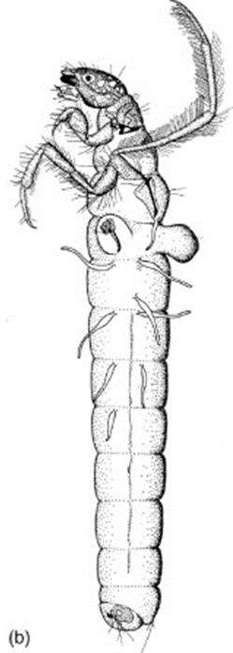
Family: Leptoceridae Nectopsyche sp.
Case of Nectopsyche is of plant material and has one twig or conifer needle running alongside case and will stick past one end (Fig. A).The underside of head has a triangular apotome (Fig. B). The mesonotumlacks dark bands (Fig. C). Hind tibia has no constriction in it (Fig. D). Two bands of spines near anal opening on abdominal segment IX (Fig. E).

Slide 28
Family: Leptoceridae Oecetis sp.
Oecetisform cases from various materials (Fig. B & C). The mouthparts are your best bet for identifying Oecetis. The mandibles are sharp and bladelike (Fig. D). The maxillary palpi extend beyond the rest of the mouthparts (Fig. E).

Slide 29
Family: Leptoceridae Setodes sp.

Slide 30
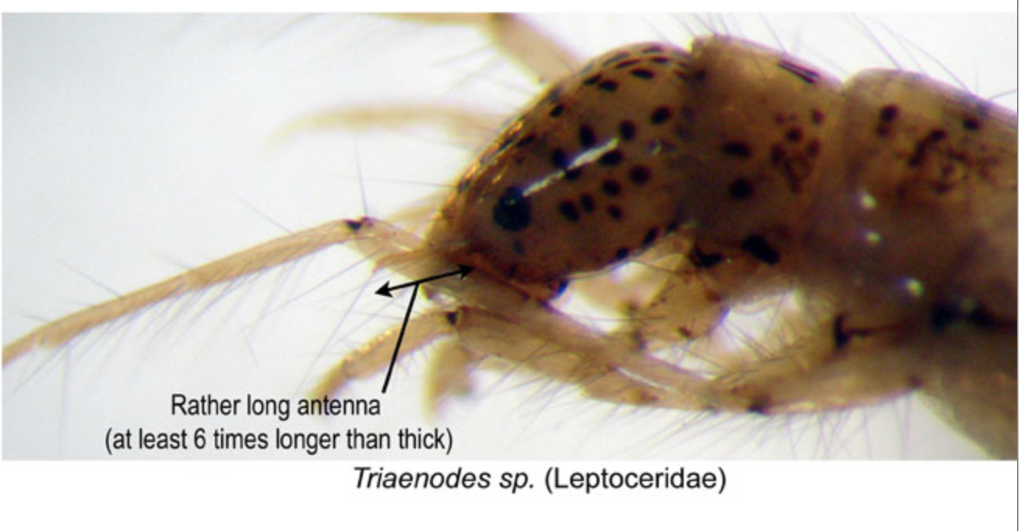
Family: Leptoceridae Trianodes sp.
Rather long antenna
At least 6x longer than thick
The case is composed of plant pieces (Fig. B). When looking at the head from above, you won�t find much color variation. Instead, you will usually find a dark head featuring a white or cream crescent pointing towards it�s anterior end (Fig. C). Finally, the metathoracic legs feature a set of close, long hairs (Fig. D).

Slide 31
Family: Polycentropodidae
The anal claw of Polycentropodidae is hook shaped (Fig. B).
The trochantin is pointed (Fig. C). This pointed trochantin helps distinguish Polycentropodidae from the Family Psychomyiidae, which has a hatchet shaped trochantin.
Their abdomen lacks gills (Fig. D) and the mesonotum is largely membranous (Fig. E). They do not make portable cases.

Slide 32
Family: Polycentropodidae Cernotina sp.

Slide 33
Family: Polycentropodidae Neureclipsis sp.

Slide 34
Family: Polycentropodidae Nyctiophylax sp.

Slide 35
Family: Polycentropodidae Phylocentropus sp.

Slide 36
Family: Polycentropodidae Polycentropus sp.

Slide 37
Family: Polycentropodidae Polyplectropus sp.

Slide 38
Family: Odontoceridae Marilia sp.

Slide 39
Family: Brachycentridae Brachycentrus sp.
First abdominal segment lacks any kind of humps (Fig. A).
The humpless case makers also have the second thoracic segment with either well-developed or connecting plates (Fig. B).
The type we have collected in North Dakota (genus Brachycentrus) has a four sided case which tapers to the posterior end (Fig. C).
Brachycentrusmeso and meta tibiae (Fig. D) have a line of stout spines (Fig. E).

Slide 40
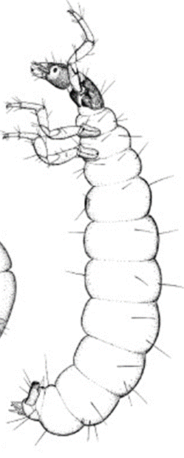
Family: Glossosomatidae Protoptila sp.
tortoise-shell shaped case. (do not have a specimen with its' case)
thoracic segments two and three usually fleshy or with small separated plates (Fig. B)
the basal portion of their anal claw is broadly joined to the abdomen(Fig. C)
anal claw hook shaped and bearing at least one accessory hook (Fig. C)
they lack a posternal horn (Fig. D)
abdominal segment nine with sclerite on dorsum (Fig E).

Slide 41
Family: Hydrobiosidae Atopsyche sp.

Slide 42
Family: Rhyacophilidae Rhyacophila sp.

